Slide 1
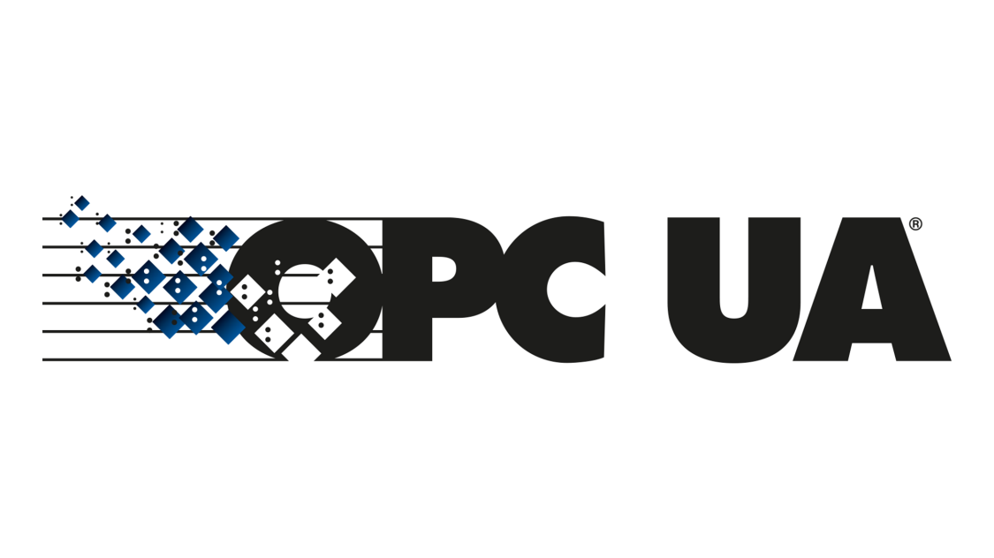
What is an OPC UA?
Open Platform Communications Unified Architecture
OPC UA is a data exchange standard for industrial communication (machine-to-machine or PC-to-machine communication).

Slide 2

OPC Foundation
The OPC Foundation is the organization behind the standard and with 678 members it has very broad base.
Its members include global players in the automation industry. For example: Siemens, Honeywell, Microsoft, Beckhoff, SAP, Yokogawa, ABB, Rockwell, Schneider Electric, Wago, Iconics and others.

Slide 3
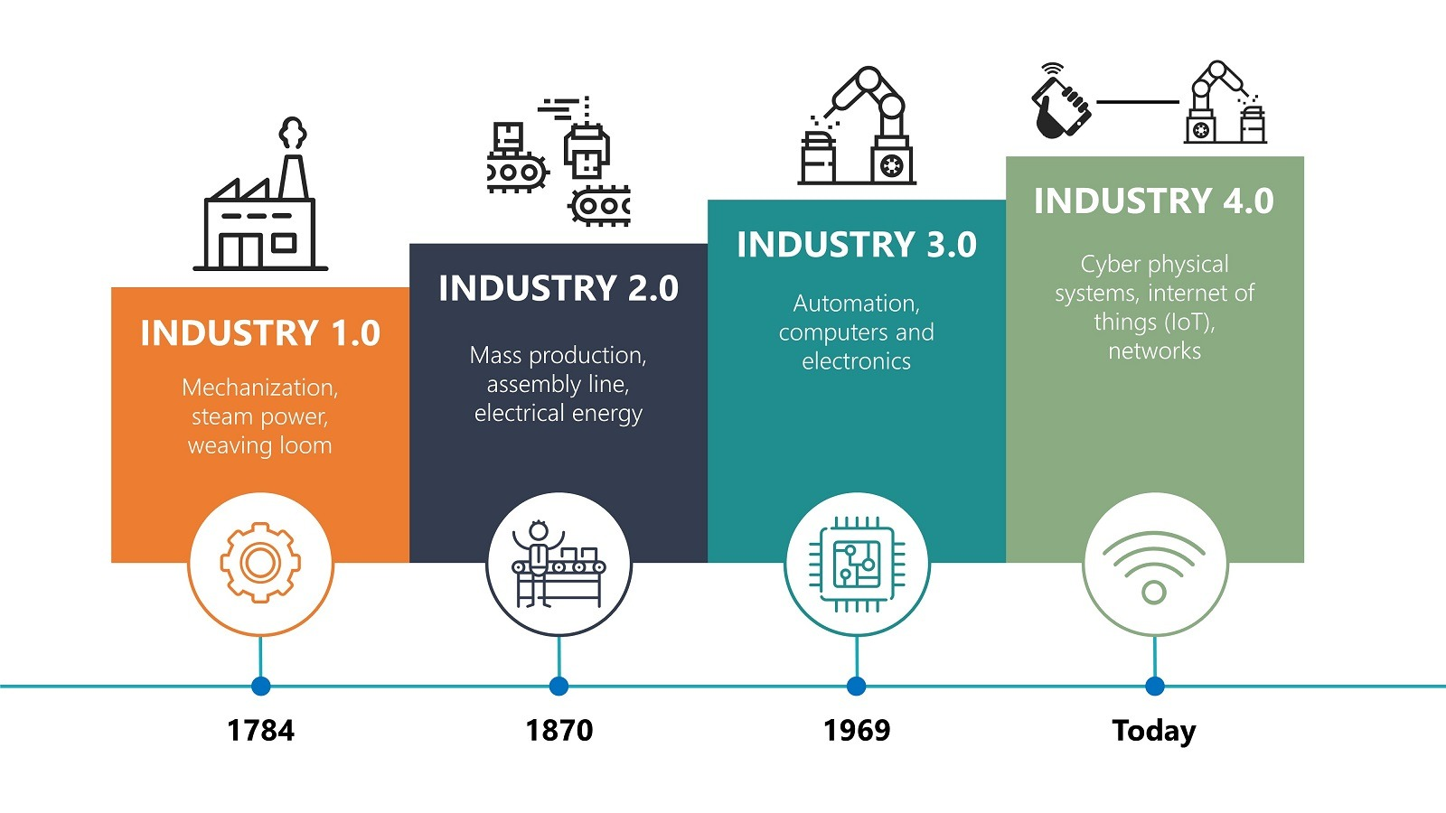
Industry 4.0
Industry 4.0 is the latest evolution of manufacturing.
It refers to the transformation of industry through the intelligent networking of machines and processes with the help of information and communication technology (ICT).
Different kinds of sensors gives the opportunity for making of smart factories where every machine action is traced.

Slide 4
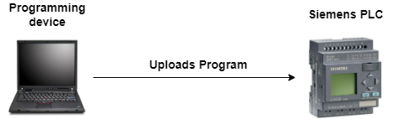
W hat is a PLC?
Programmable Logic Controller (PLC) is simply a special industrial computer that is programmed to control certain processes in industries like petroleum, steel or automotive industry. It contains three main parts: Input Module, CPU and Output Module.
There is also a programming computer, on which is written the program that will execute (and control) on PLC. When the program is written, it has to be uploaded to the PLC.

Slide 5
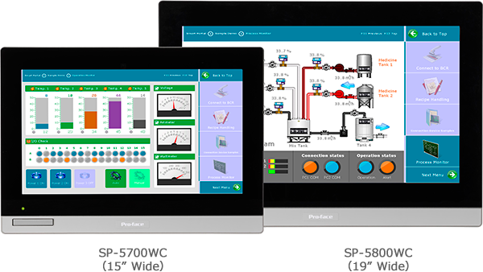
What is an HMI?
A Human-Machine Interface (HMI) is a user interface or dashboard that connects an operator to controller for an industrial system (for example PLC) .
In industrial the HMI can be used for: Visual display of data, Track production time, Monitor machine inputs and outputs, oversee KPIs, etc.

Slide 6
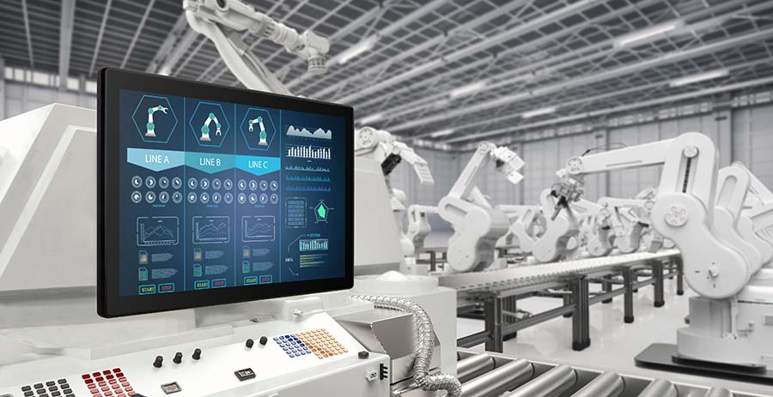
HMI in real environment

Slide 7
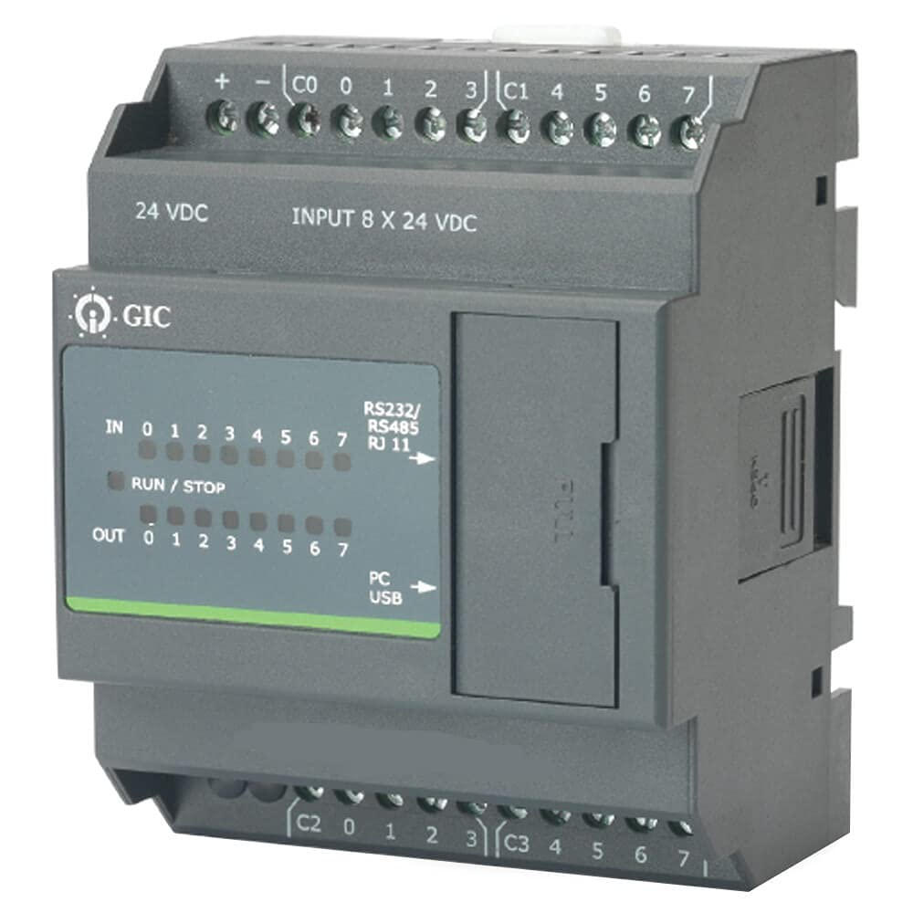
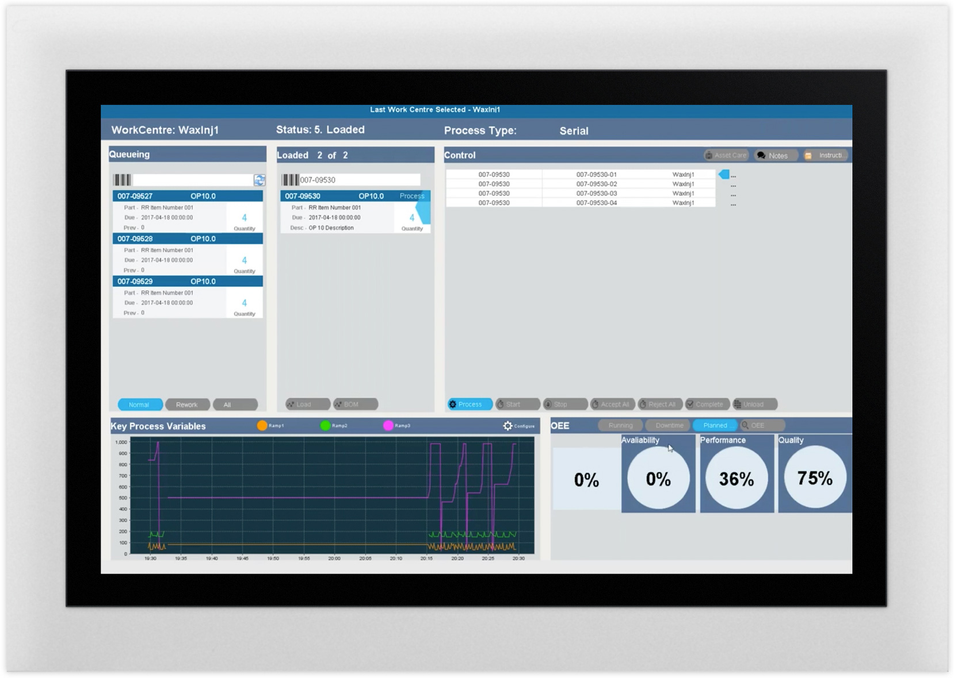
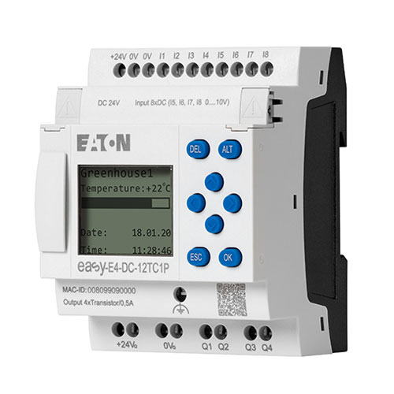
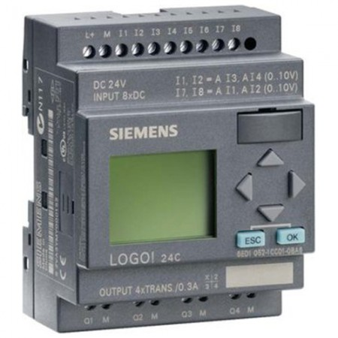
What was before OPC? Driver diversity problem!
GIC PLC
GIC driver
EATON driver
Siemens driver
EATON PLC
HMI system
Siemens PLC

Slide 8

Classic OPC
GIC PLC
Windows PC
OPC Server
COM/DCOM
EATON PLC
HMI system (OPC client)
Siemens PLC

Slide 9

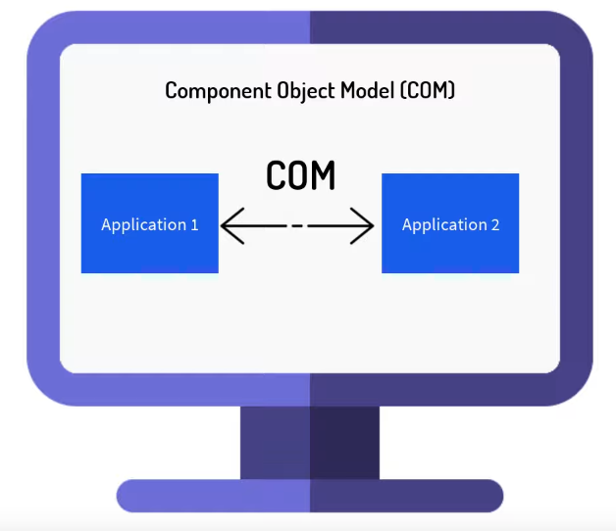
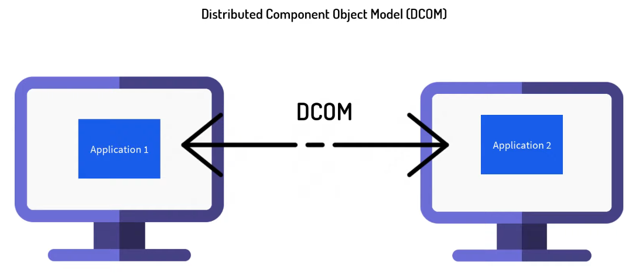
Classic OPC
The communication is based on COM and DCOM which are Microsoft technologies.
It works only on Windows machines and has not so rich features like OPC UA.
OPC is a software interface standard that allows Windows programs to communicate with industrial hardware devices.

Slide 10

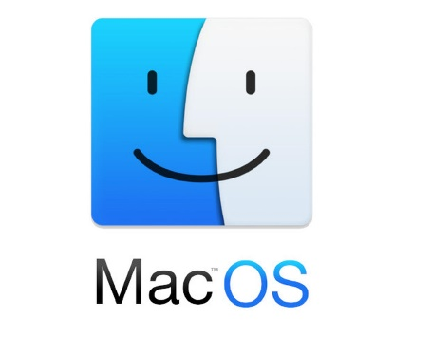

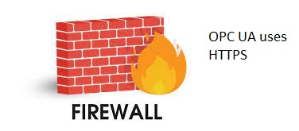
OPC UA
Platform Independence
OPC UA first release is in 2008.
It has many more features than the old OPC.
It is platform independent and not only for Windows.
It has built in security and is Internet friendly oriented (No Firewall problems).
It is designed for work in Internet and specially for Industry 4.0.
It relies on TCP/IP protocol stack and uses Https and OPC binary protocol.
OPC UA
Firewall friend

Slide 11
OPC UA
GIC PLC
OPC Server
Eaton PLC
HMI system (OPC client)
Siemens PLC

Slide 12

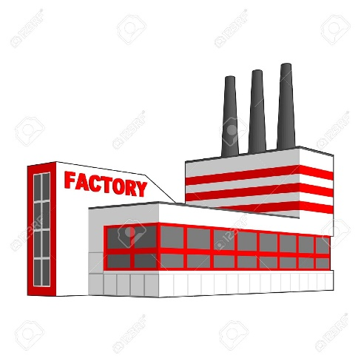


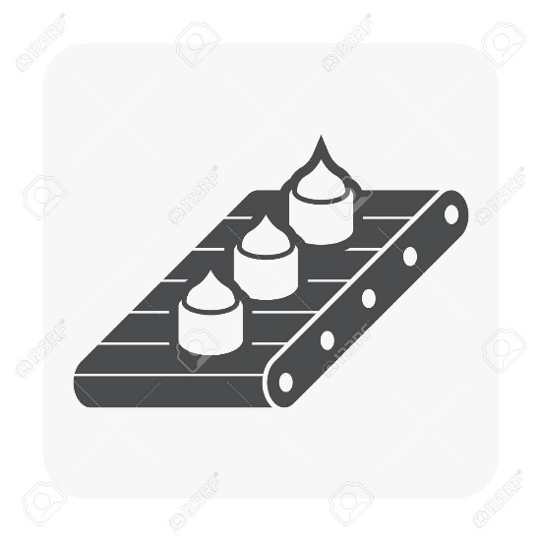
Where is used OPC UA?
OPC UA

Slide 13
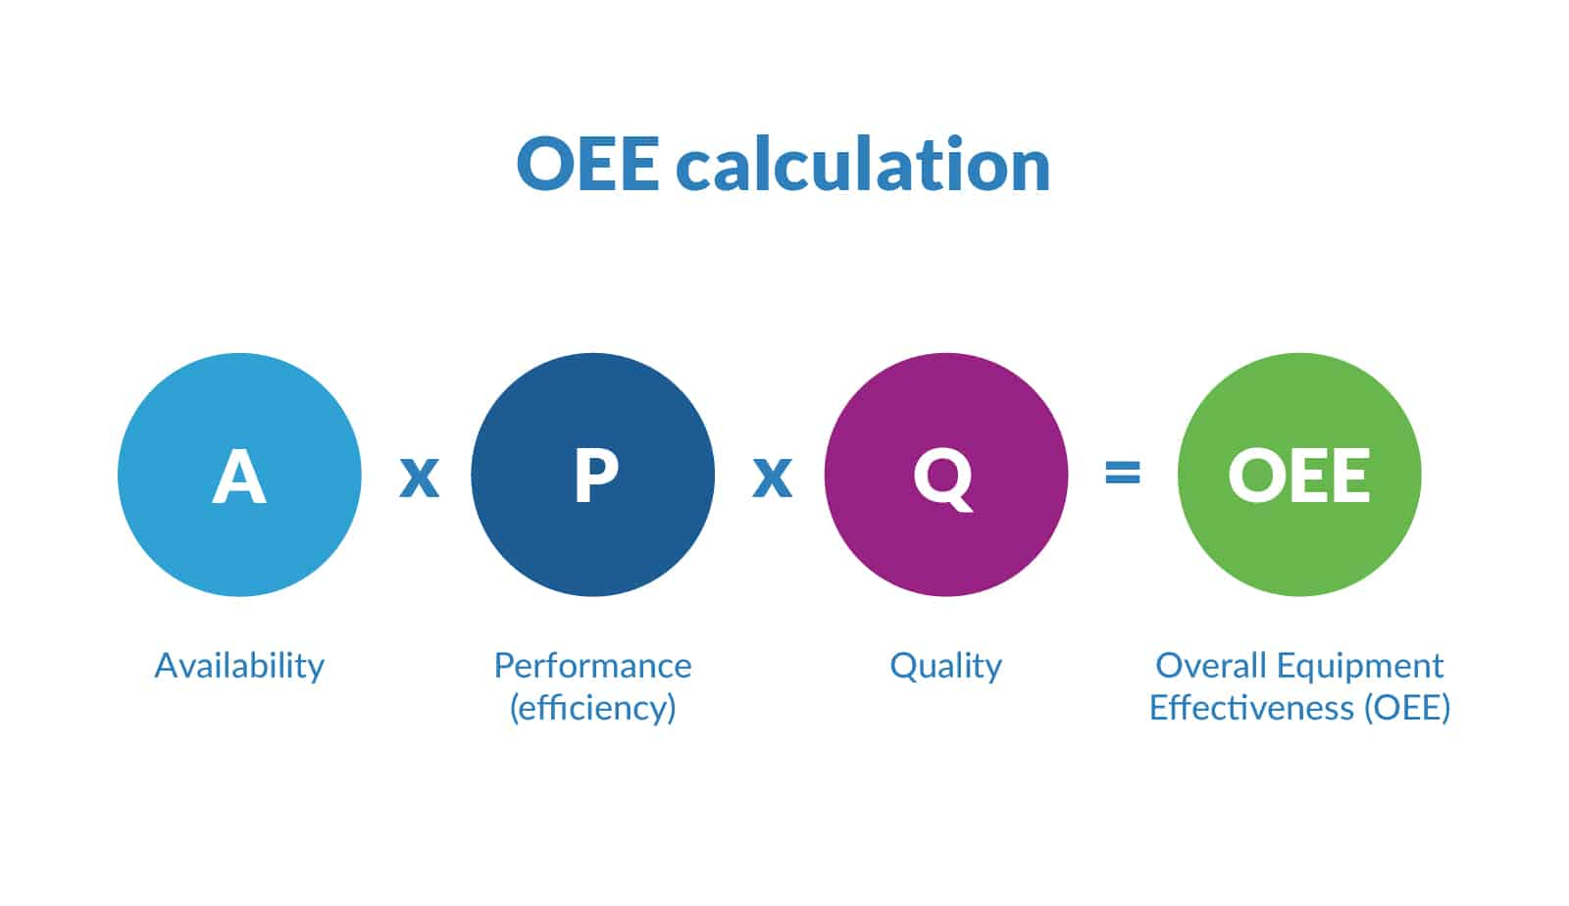
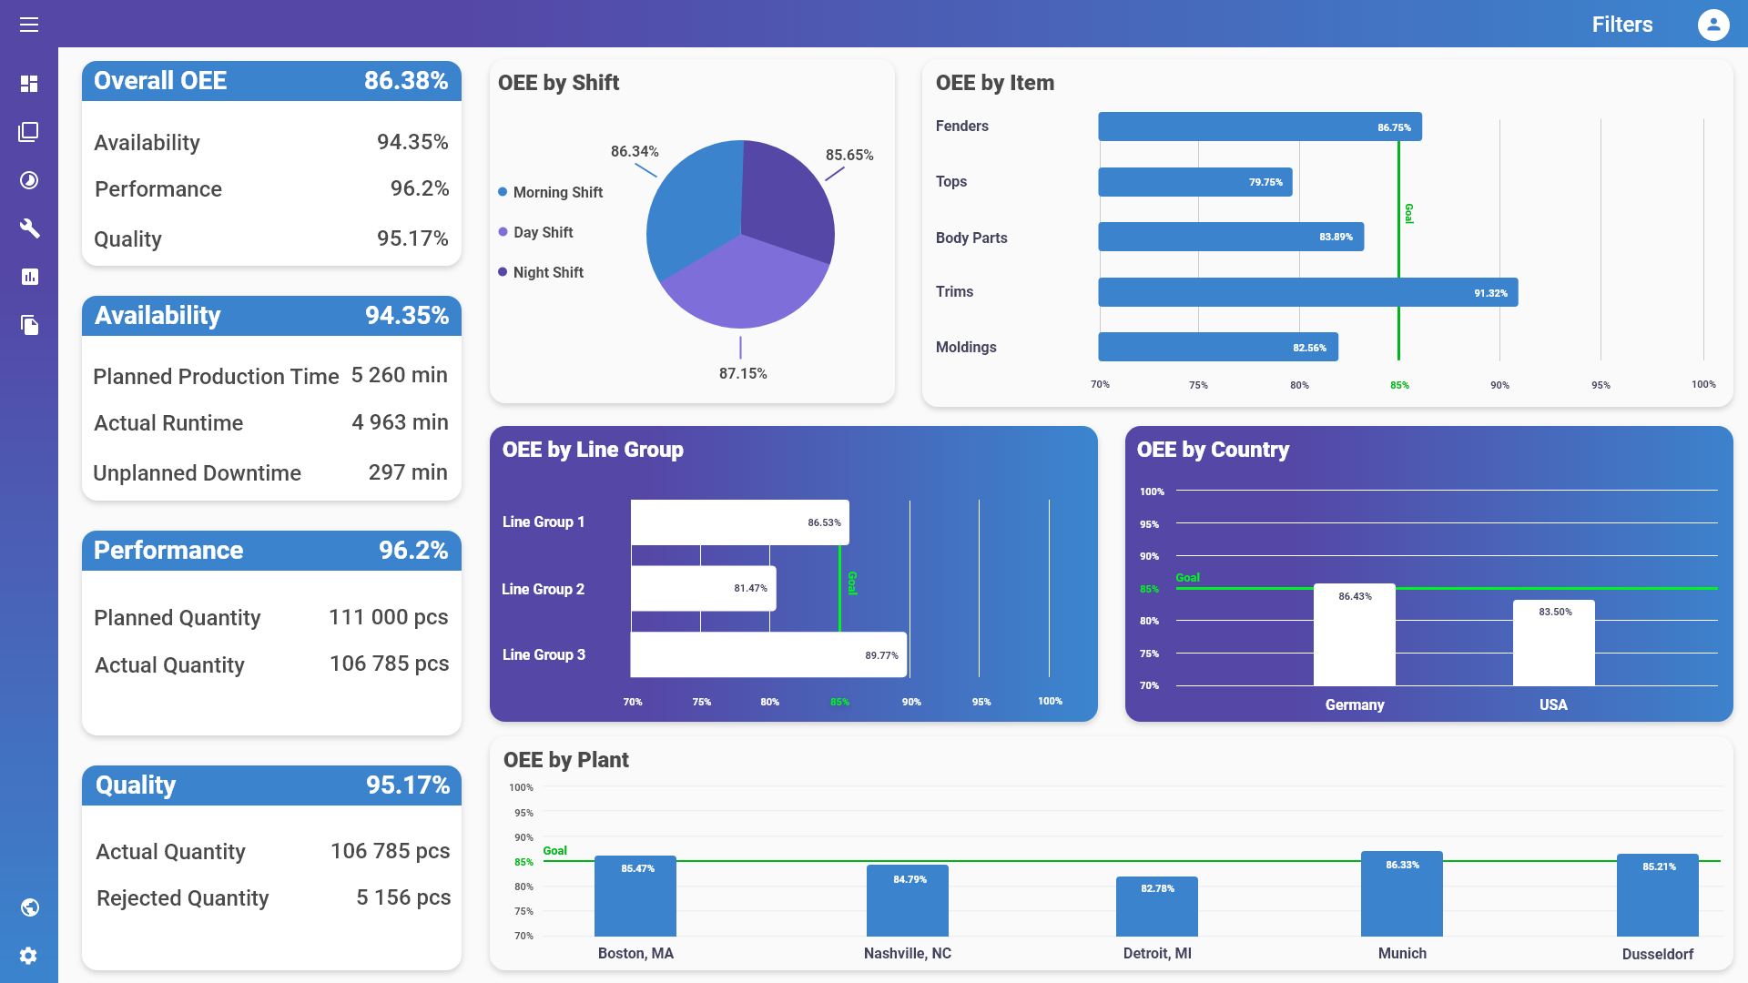
OEE (Overall Equipment Effectiveness)
It’s a gold standard for measuring manufacturing productivity.
By measuring of OEE and the underlying losses, we can get important insights on how to systematically improve our manufacturing process.

Slide 14
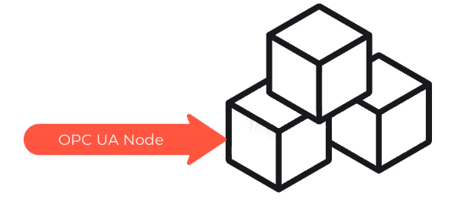
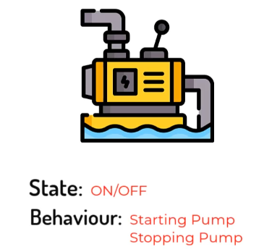
OPC UA Specifications
Information model
Communication architectures
Security
Historical access
Alarms and Events
Programs
"ns=2;s=/FloorOne/Machines/Pump"

Slide 15

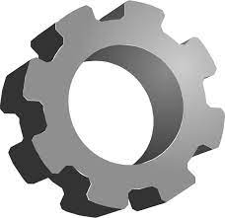
Communication architectures
Pub/Sub model (notifications)
Client/Server model (session)
client
client
server
server
client
session
client
client

Slide 16
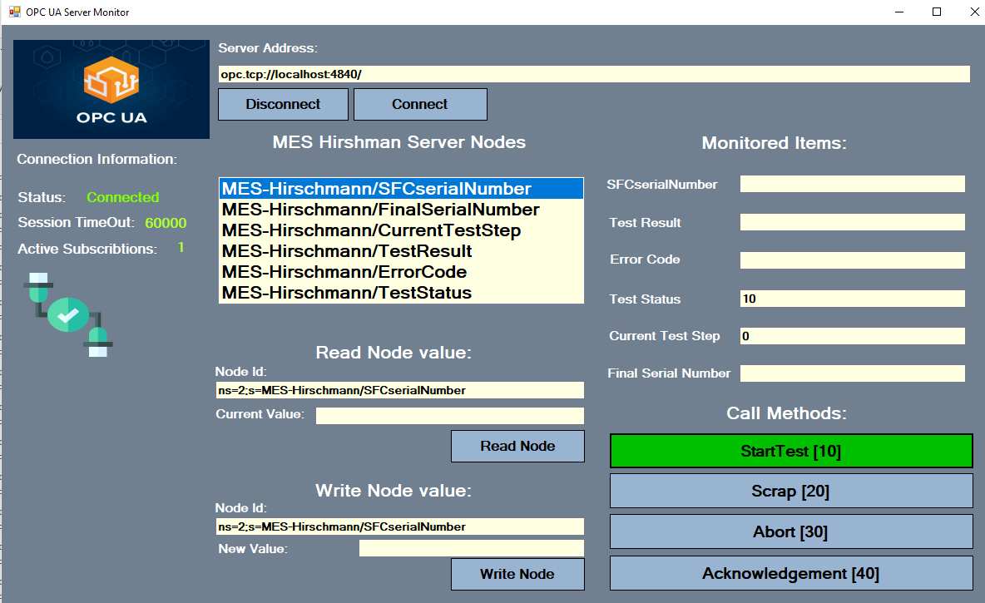

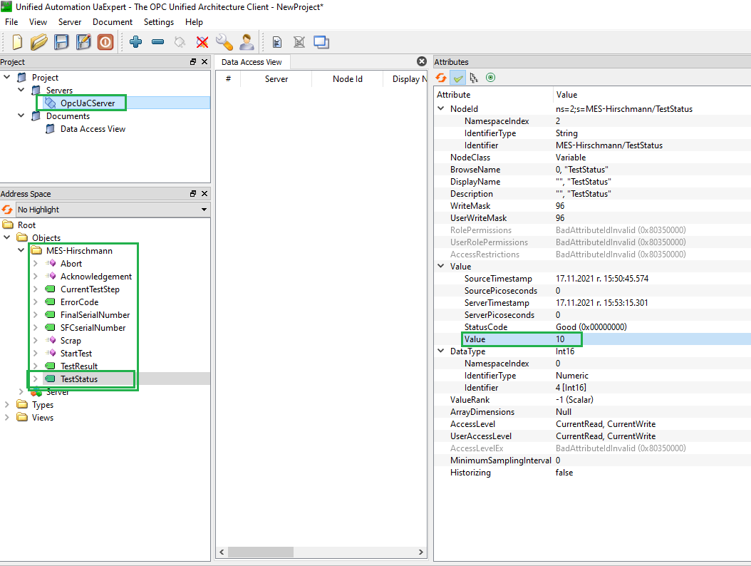
Hirschman project
client
read
server
write
read
publisher
client
write
subscriber

Slide 17
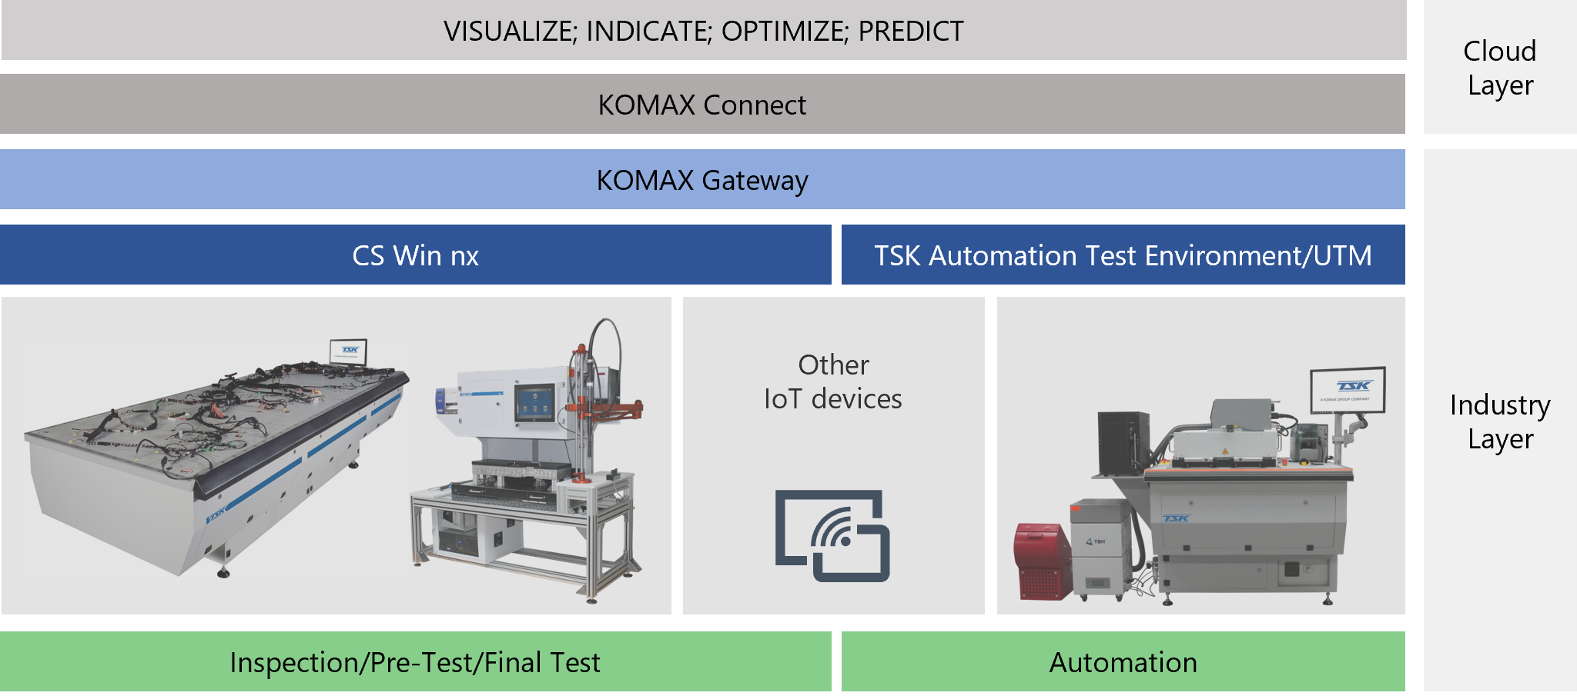
Komax Connect Project
We already have an initial connection between CS WIN and the cloud KOMAX system.
For this purpose was developed CS WIN COM object which serves as a OPC UA client and OPC UA server which is a Windows service app that running on the same PC.

Slide 18


KOMAX Connect Project
CS WIN
(OPC UA client
– COM object)
KOMAX Gateway
OPC UA server (Win service)
Cloud dashboard
write data
read data
OPC UA
OPC UA

Slide 19
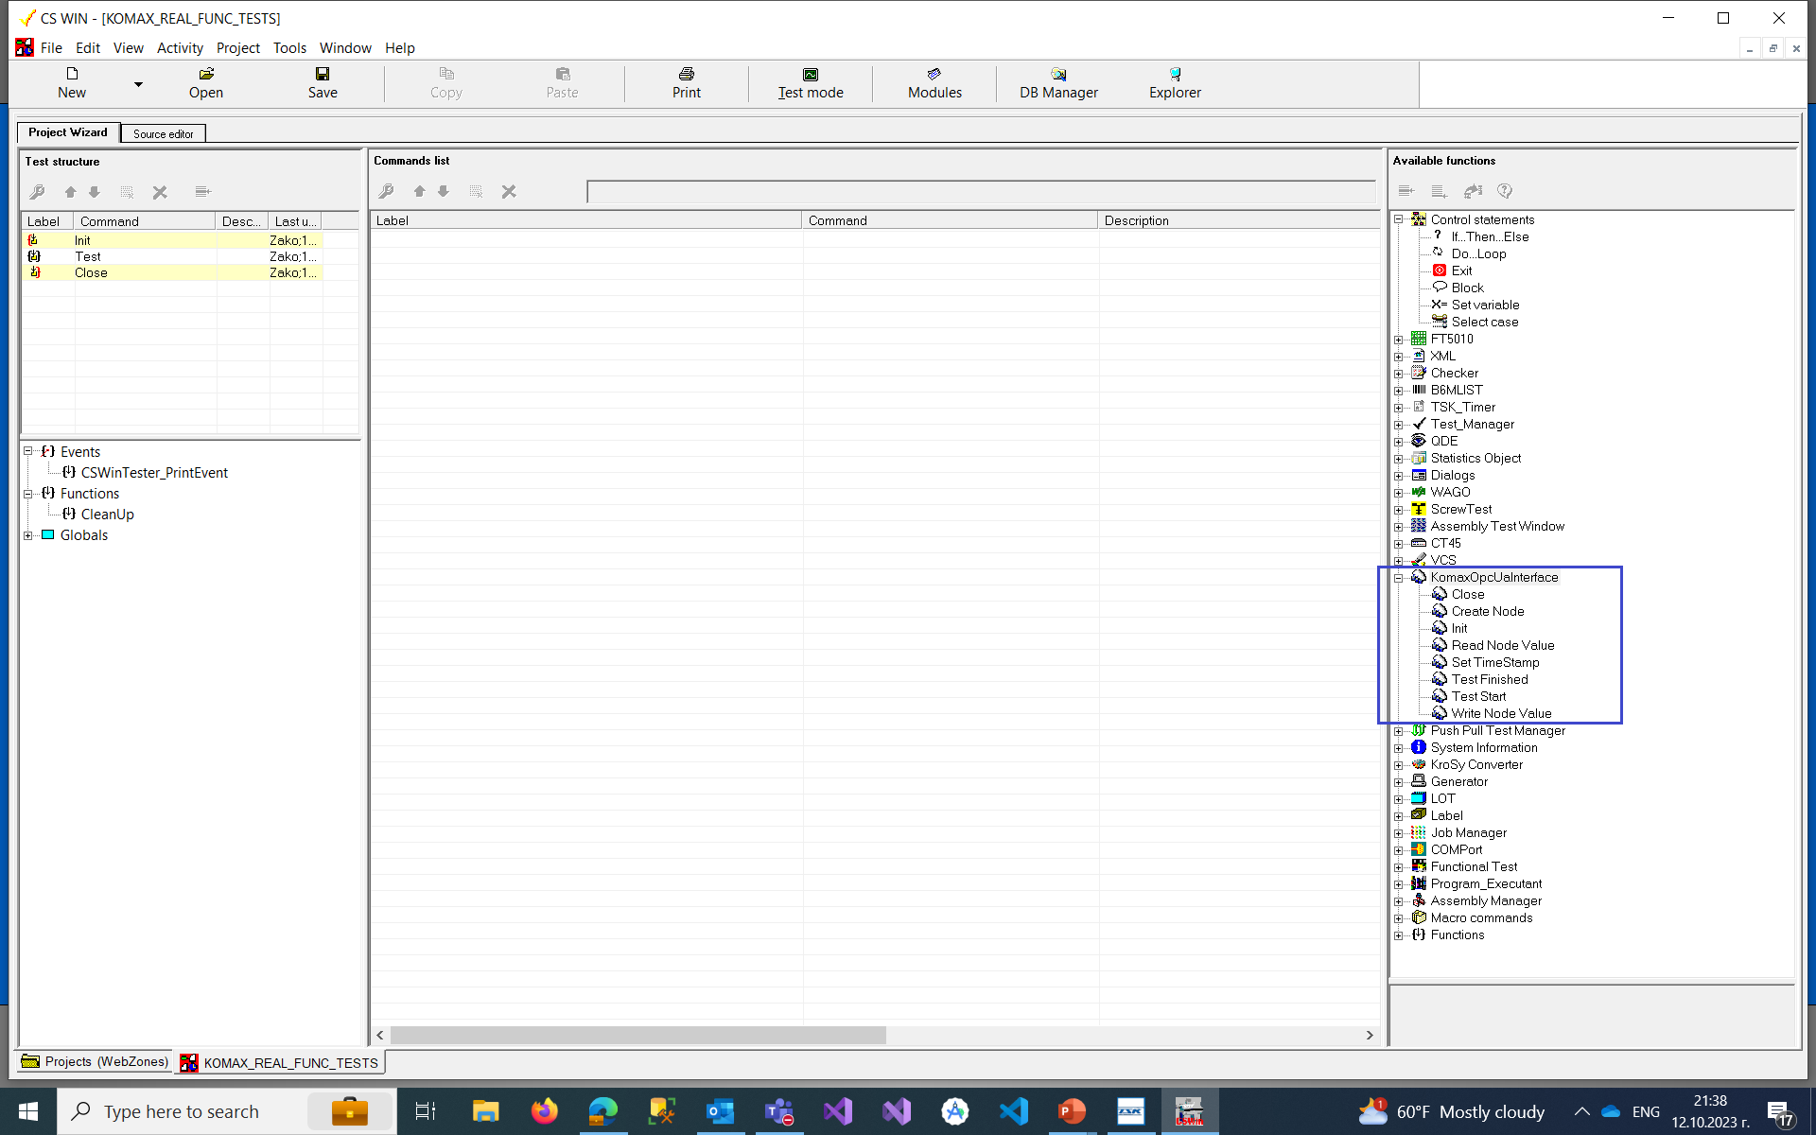
View from Komax Connect client in CS WIN

